Slide 1
Church
History
The Apostasy
Began With A Distinction in the Eldership
Local Church
E E E E
D D D
Members
Local Church
Presiding Elder
E E E E
D D D
Members
Local Church
Bishop
E E E E
D D D
Members

Slide 2
Church
History
The Apostasy
Presiding Elders & Bishops began to meet in local areas
PE PE B B PE B
B PE B B PE PE
Co. B.
Country Bishops from larger area began to meet
Co. B Co. B Co. B
Co. B Co. B Co. B
City B.

Slide 3
Church
History
The Apostasy
The First Pope
Jerusalem
Antioch
Constantinople
Rome
Alexandria
A.D. 588 – “Papa” John the Faster usurped the title of Universal Bishop.
A.D. 606 – Roman Emperor rebuked John & designated Boniface III of Rome Universal Bishop.

Slide 4
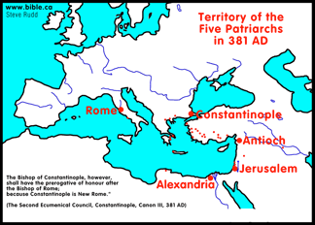

Slide 6
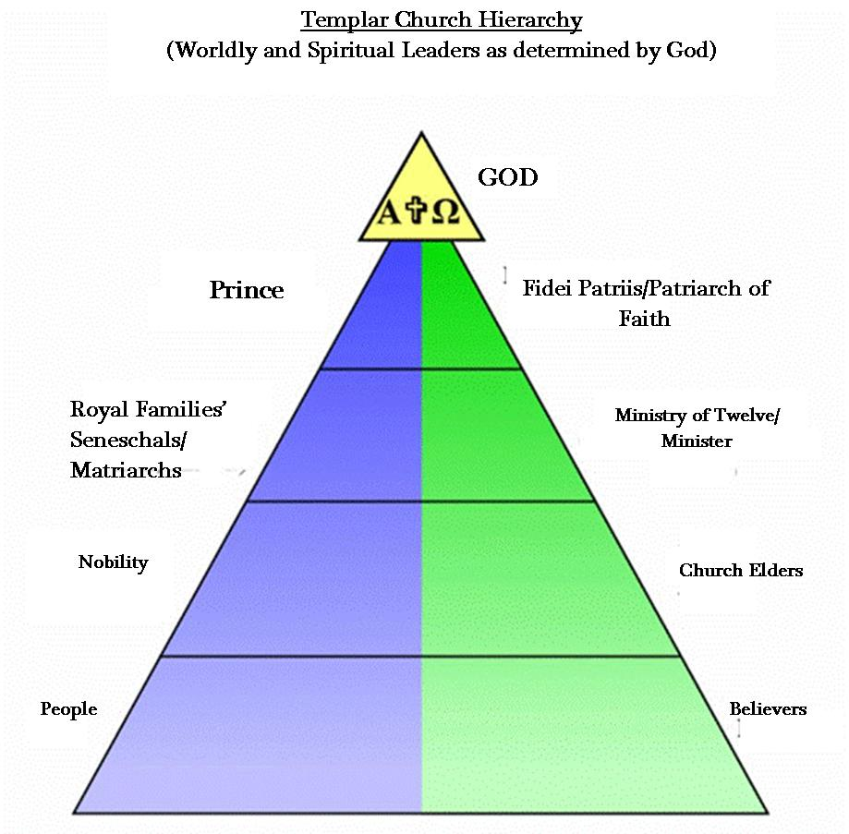

Slide 7
Church
History
The Apostasy
Apostasy Grows
Council of Nicea 325 A.D.
PE Co. B Cty. B PE Co. B PE
Cty. B Co. B Co. B PE Cty. B PE
PE Cty. B Cty. B PE Co. B PE
Constantine Emperor of Rome

Slide 8
Church
History
The Apostasy
Apostasy Grows
Council of Nicea 325 A.D.
First Council of Constantinople 381 A.D.
Council of Ephesus 431 A.D.
Council of Chalcedon 451 A.D.
Second Council of Constantinople 553 A.D.
Third Council of Constantinople 680 A.D.
Second Council of Nicea 787 A.D.

Slide 9
Church
History
The Apostasy
Doctrines Enacted at Church Councils
Clergy/Laity System
Sprinkling for Immersion
Infant Baptism
Celibacy
Instrumental Music
Transubstantiation
Indulgences
Worship of Mary
Veneration of Relics
Purgatory
Confessionals
Images
Penance
Extreme Unction
Confirmation
Nuns, Primacy of Peter
Forbidding to Eat Meats
Religious Holidays

Slide 10
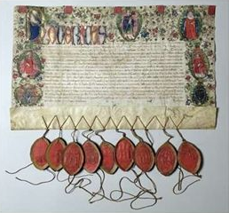
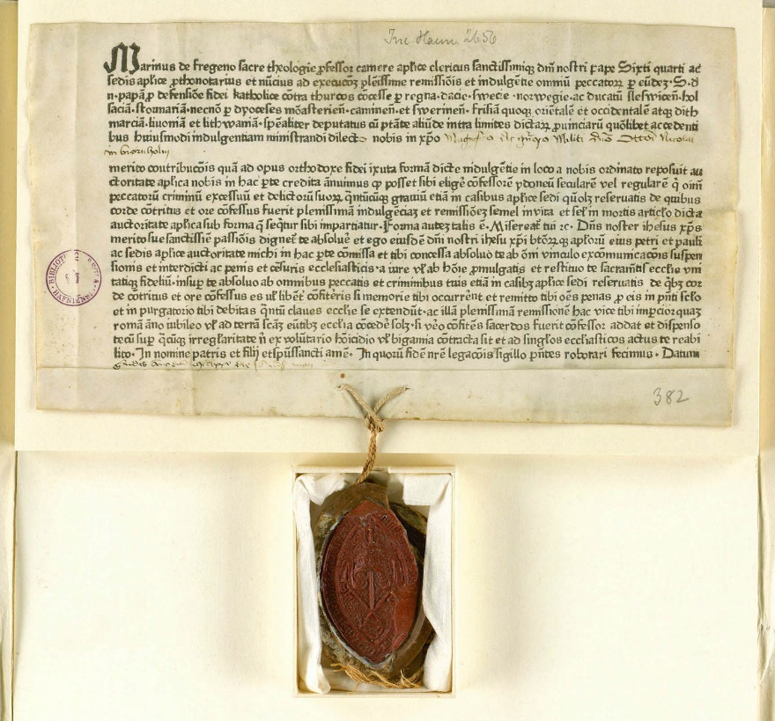
Indulgences

