Slide 1
Genesis 17
Renewal and Confirmation of the Covenant

Slide 4
The Lord...Almighty God
Lit: “Jehovah...El Shaddai.”
Jehovah = The eternal, ever being one.
El(ohim) = Might, power, omnipotence.
Shaddai = All sufficient and all bountiful to supply all blessings, fruitfulness and necessities.
Cf: Eph 3:20; 2 Cor 12:8,9
Notes:
Genesis 17:1
The Covenant of Circumcision
When Abram was ninety-nine years old, the Lord appeared to him and said, “I am God Almighty(48x's); walk before me faithfully and be blameless.
Ephesians 3:20
Now to him who is able to do immeasurably more than all we ask or imagine, according to his power that is at work within us,
2 Corinthians 12:8-9
Three times I pleaded with the Lord to take it away from me. But he said to me, “My grace is sufficient for you, for my power is made perfect in weakness.” Therefore I will boast all the more gladly about my weaknesses, so that Christ’s power may rest on me.

Slide 5
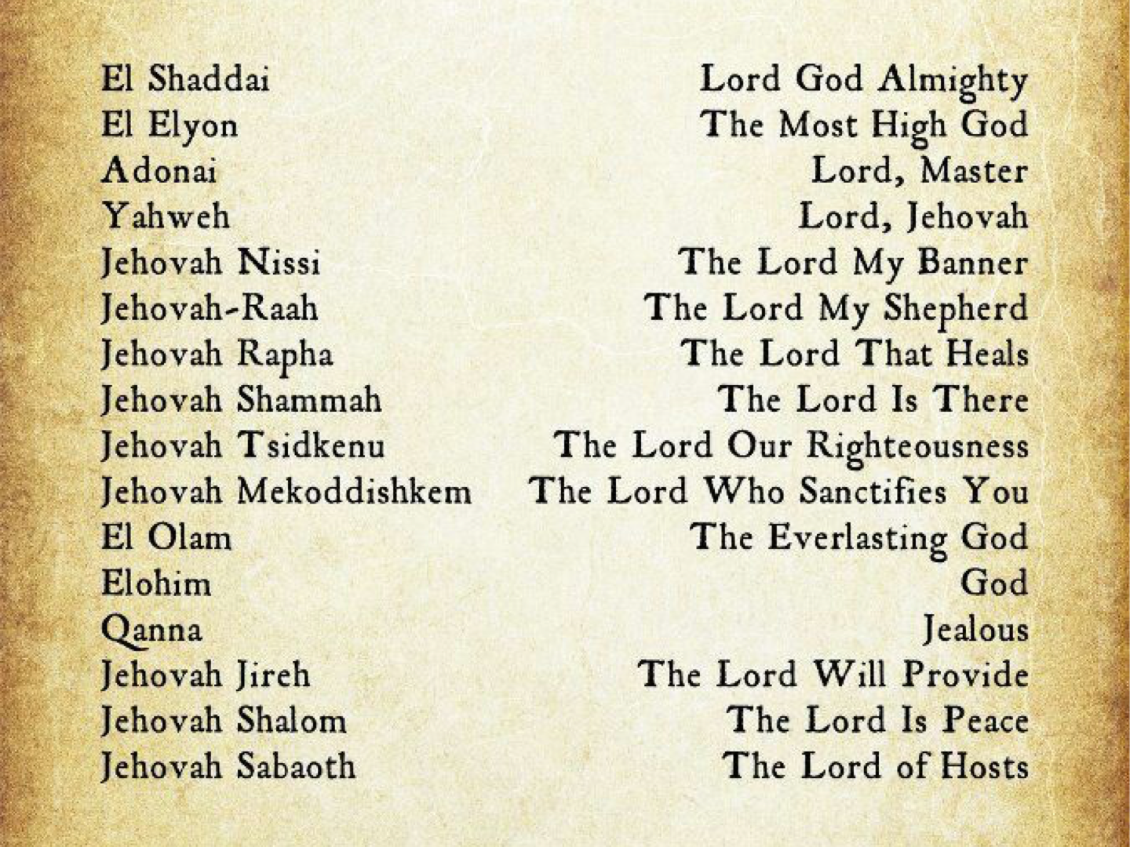

Slide 6
Walk before me - true religion.
Be blameless (thou perfect)
the practice of true religion

Slide 7
2 Then I will make my covenant between me and you and will greatly increase your numbers.”
Genesis 17:2 (NIV)
Notes:
2) I will make- the practice of true religion. - The covenant is already made (15:18); this means, “to make operative the covenant that is in force.” The time has come for the promised son to come.
Genesis 15:18
On that day the Lord made a covenant with Abram and said, “To your descendants I give this land, from the Wadi of Egypt to the great river, the Euphrates—

Slide 8
No longer shall your name be called Abram, but your name shall be Abraham, for I have made you the father of a multitude of nations. I will make you exceedingly fruitful, and I will make you into nations, and kings shall come from you. And I will establish my covenant between me and you and your offspring after you throughout their generations for an everlasting covenant, to be God to you and to your offspring after you.
Genesis 17:5-7
Notes:
5) Abram...Abraham . From “high father” to “father of a multitude.”

Slide 9
8 The whole land of Canaan, where you now reside as a foreigner, I will give as an everlasting possession to you and your descendants after you; and I will be their God.”
Genesis 17:8
Notes:
8) Everlasting . “Age or age lasting” It will last as long as the age is intended to last!

Slide 10
The Covenant Sign vv. 9-14
Genesis 17:9-11
And God said to Abraham, “As for you, you shall keep my covenant, you and your offspring after you throughout their generations. This is my covenant, which you shall keep, between me and you and your offspring after you: Every male among you shall be circumcised. You shall be circumcised in the flesh of your foreskins, and it shall be a sign of the covenant between me and you.

