Slide 1
Taught at: Schrader Lane Church of Christ 2023
5
A Time for Everything
Part 2
Ecc. 3:11-22
Barry G. Johnson, Sr. - Facilitating

Slide 2
New Coming Soon: Ecclesiastes: A Striving After the Wind Wednesdays through November 8th On Zoom @ 6:15 p.m. Free PDF Book & Student Workbook available for download at www.BarrysBureau.com/Ecclesiastes.html Barry Johnson, Sr. - Facilitating

Slide 3
Darrell Moore
No need to feel jealousy or envy toward anyone who appears to possess more than I do looks better than I look, or seems to be doing better than I'm doing. We will all return to the dust, which is the great equalizer. Knowing God's love is way better than being concerned about other people's possessions. This knowledge places all things into proper perspective and gives us great access to living a more focused and purposeful life in the service of others.
Notes:
Darrell Moore
No need to feel jealousy or envy toward anyone who appears to possess more than I do looks better than I look, or seems to be doing better than I'm doing. We will all return to the dust, which is the great equalizer. Knowing God's love is way better than being concerned about other people's possessions. This knowledge places all things into proper perspective and gives us great access to living a more focused and purposeful life in the service of others.

Slide 4
Effie Boothe
Don't be overcome with despondency! Attitude helps us move our lives from cynicism (horizontal view) to hope by faith ( vertical view.)

Slide 5
Solomon’s Search
Wisdom
Pleasure
Prudent/Foolish Life
Work
Life Events

Slide 6
Conclusion
Life is the Pits

Slide 7
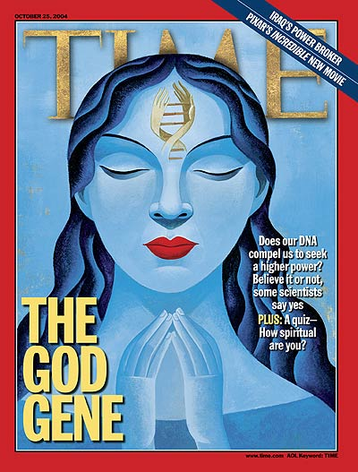

Slide 8
Vertical View
God makes sense of chaos

Slide 9
He has made everything appropriate in its time. He has also set eternity in their heart, yet so that man will not find out the work which God has done from the beginning even to the end.
- Ecc. 3:11

Slide 10
The heavens are telling of the glory of God;
And their expanse is declaring the work of His hands.
- Ps. 19:1

Slide 11
Let everything that has breath praise the Lord.
Praise the Lord!
- Ps. 150:6

Slide 12
And we know that God causes all things to work together for good to those who love God, to those who are called according to His purpose.
- Rom. 8:28

Slide 13
Vertical View
God makes sense of chaos
God enables us to enjoy life

Slide 14
I know that there is nothing better for them than to rejoice and to do good in one’s lifetime; moreover, that every man who eats and drinks sees good in all his labor—it is the gift of God.
- Ecc. 3:12-13

Slide 15
Vertical View
God makes sense of chaos
God enables us to enjoy life
God provokes us to worship Him

Slide 16
I know that everything God does will remain forever; there is nothing to add to it and there is nothing to take from it, for God has so worked that men should fear Him. That which is has been already and that which will be has already been, for God seeks what has passed by.
- Ecc. 3:14-15

Slide 17
Horizontal View
Breeds Cynicism

Slide 18
Furthermore, I have seen under the sun that in the place of justice there is wickedness and in the place of righteousness there is wickedness.
- Ecc. 3:16

Slide 19
Then I looked again at all the acts of oppression which were being done under the sun. And behold I saw the tears of the oppressed and that they had no one to comfort them; and on the side of their oppressors was power, but they had no one to comfort them.
- Ecc. 4:1

Slide 20
So I congratulated the dead who are already dead more than the living who are still living. But better off than both of them is the one who has never existed, who has never seen the evil activity that is done under the sun.
- Ecc. 4:2-3

Slide 21
If you see oppression of the poor and denial of justice and righteousness in the province, do not be shocked at the sight; for one official watches over another official, and there are higher officials over them.
- Ecc. 5:8

Slide 22
All this I have seen and applied my mind to every deed that has been done under the sun wherein a man has exercised authority over another man to his hurt.
- Ecc. 8:9

Slide 23
Horizontal View
Solutions to Cynicism
Injustice is Temporary

Slide 24
I said to myself, “God will judge both the righteous man and the wicked man,” for a time for every matter and for every deed is there.
- Ecc. 3:17

Slide 25
Horizontal View
Solutions to Cynicism
Injustice is Temporary
Injustice Condemns

Slide 26
I said to myself concerning the sons of men, “God has surely tested them in order for them to see that they are but beasts.” For the fate of the sons of men and the fate of beasts is the same. As one dies so dies the other; indeed, they all have the same breath and there is no advantage for man over beast, for all is vanity.
- Ecc. 3:18-19

Slide 27
All go to the same place. All came from the dust and all return to the dust. Who knows that the breath of man ascends upward and the breath of the beast descends downward to the earth?
- Ecc. 3:20-21

Slide 28
Horizontal View
Solutions to Cynicism
Injustice is Temporary
Injustice Condemns
Hope Beyond Cynicism

Slide 29
I have seen that nothing is better than that man should be happy in his activities, for that is his lot. For who will bring him to see what will occur after him?
- Ecc. 3:22

Slide 30
Hopeful Realism
What is your unjust disadvantage?

Slide 31
Hopeful Realism
When do you plan to replace passive self-pity with active courage?

Slide 32
Hopeful Realism
How can God use you?

Slide 33
Changing our attitude will change our lives from cynicism to hope.

