Slide 1
The Divine Claim
John 10:31-33

Slide 2
The Divine Claim
John 10:31-33 (NIV)
31 Again his Jewish opponents picked up stones to stone him, 32 but Jesus said to them, “I have shown you many good works from the Father. For which of these do you stone me?”
33 “We are not stoning you for any good work,” they replied, “but for blasphemy, because you, a mere man, claim to be God.”

Slide 3
NT affirms Jesus Christ’s Divinity
The Divine Claim

Slide 4
Hebrews 1:8 (NIV) — 8 But about the Son he says, “Your throne, O God, will last for ever and ever; a scepter of justice will be the scepter of your kingdom.
NT affirms Jesus Christ’s Divinity

Slide 5
Statements which imply Jesus Divinity
The Divine Claim

Slide 6
1 John 5:20 (NIV) — 20 We know also that the Son of God has come and has given us understanding, so that we may know him who is true. And we are in him who is true by being in his Son Jesus Christ. He is the true God and eternal life.
Statements which imply Jesus Divinity

Slide 7
Jesus Names and Titles Point to His Divinity
The Divine Claim

Slide 8
Jesus Christ as Judge
Jesus Christ as “I am”
Jesus Christ as Saviour
Jesus Christ as Lord
Jesus Christ as Creator
Jesus Christ as Shepherd
Jesus Names and Titles Point to His Divinity

Slide 9
Recognizing Jesus Christ’s Divinity
The Divine Claim

Slide 10
The Disciples
John 20:28 (NIV) — 28 Thomas said to him, “My Lord and my God!”
Recognizing Jesus Christ’s Divinity

Slide 11
The Demons
Luke 4:41 (NIV) — 41 Moreover, demons came out of many people, shouting, “You are the Son of God!” But he rebuked them and would not allow them to speak, because they knew he was the Messiah.
Recognizing Jesus Christ’s Divinity

Slide 12
Jesus Christ’s Eternal Nature Indicates His Divinity
The Divine Claim

Slide 13
Jesus Christ Precedes Creation
Colossians 1:17 (NIV) — 17 He is before all things, and in him all things hold together.
1 John 1:1 (NIV) — 1 That which was from the beginning, which we have heard, which we have seen with our eyes, which we have looked at and our hands have touched—this we proclaim concerning the Word of life.
Jesus Christ’s Eternal Nature Indicates His Divinity

Slide 14
Jesus Christ is Everlasting
Hebrews 1:12 (NIV) — 12 You will roll them up like a robe; like a garment they will be changed. But you remain the same, and your years will never end.”
Jesus Christ’s Eternal Nature Indicates His Divinity

Slide 15
Jesus Christ’s Manifestation of God’s Glory Indicates His Divinity
The Divine Claim

Slide 16
Hebrews 1:3 (NIV) — 3 The Son is the radiance of God’s glory and the exact representation of his being, sustaining all things by his powerful word. After he had provided purification for sins, he sat down at the right hand of the Majesty in heaven.
Jesus Christ’s Manifestation of God’s Glory Indicates His Divinity

Slide 17
Jesus Christ’s Claims to Divinity
The Divine Claim

Slide 18
He claimed to be one with the Father
John 5:17–18 (NIV) — 17 In his defense Jesus said to them, “My Father is always at his work to this very day, and I too am working.” 18 For this reason they tried all the more to kill him; not only was he breaking the Sabbath, but he was even calling God his own Father, making himself equal with God.
Jesus Christ’s Claims to Divinity

Slide 19
He demonstrated his authority to forgive sin
Luke 7:47–48 (NIV) — 47 Therefore, I tell you, her many sins have been forgiven—as her great love has shown. But whoever has been forgiven little loves little.” 48 Then Jesus said to her, “Your sins are forgiven.”
Jesus Christ’s Claims to Divinity

Slide 20
Jesus Christ’s Actions imply His Divinity
The Divine Claim

Slide 21
Matthew 8:26–27 (NIV) — 26 He replied, “You of little faith, why are you so afraid?” Then he got up and rebuked the winds and the waves, and it was completely calm. 27 The men were amazed and asked, “What kind of man is this? Even the winds and the waves obey him!”
Jesus Christ’s Actions imply His Divinity

Slide 22
Jesus Christ’s Resurrection Confirms His Divinity
The Divine Claim

Slide 23
Romans 1:4 (NIV) — 4 and who through the Spirit of holiness was appointed the Son of God in power by his resurrection from the dead: Jesus Christ our Lord.
Jesus Christ’s Resurrection Confirms His Divinity

Slide 24
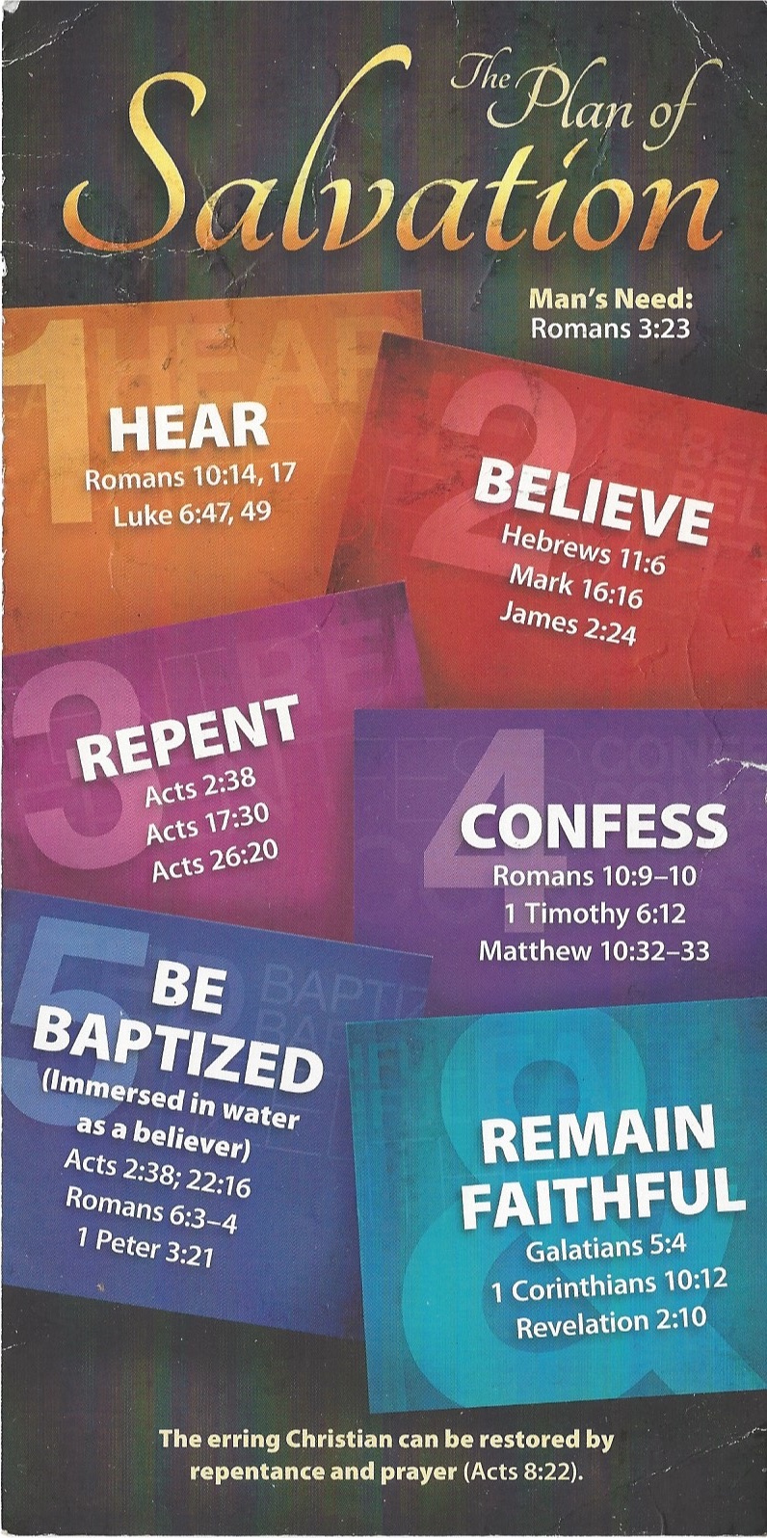
HEAR
Romans 10:14 (NIV)
14 How, then, can they call on the one they have not believed in? And how can they believe in the one of whom they have not heard? And how can they hear without someone preaching to them?
Romans 10:17 (NIV)
17 Consequently, faith comes from hearing the message, and the message is heard through the word about Christ.

Slide 25
BELIEVE
Hebrews 11:6 (NIV)
6 And without faith it is impossible to please God, because anyone who comes to him must believe that he exists and that he rewards those who earnestly seek him.

Slide 26
REPENT
Acts 17:30 (NIV)
30 In the past God overlooked such ignorance, but now he commands all people everywhere to repent.

Slide 27
CONFESS
Romans 10:9–10 (NIV)
9 If you declare with your mouth, “Jesus is Lord,” and believe in your heart that God raised him from the dead, you will be saved. 10 For it is with your heart that you believe and are justified, and it is with your mouth that you profess your faith and are saved.

Slide 28
BE BAPTIZED
1 Peter 3:21 (NIV)
21 and this water symbolizes baptism that now saves you also—not the removal of dirt from the body but the pledge of a clear conscience toward God. It saves you by the resurrection of Jesus Christ,

Slide 29
REMAIN FAITHFUL
Galatians 5:4 (NIV)
4 You who are trying to be justified by the law have been alienated from Christ; you have fallen away from grace.

