Slide 1
The Reality of Evangelism
Chapter 4 - WhEre
Being versus Doing

Slide 2
Evangelism is not simply what we do, it is who we are.

Slide 3
barrysbureau.com
Lesson #13 Evangelism - Where Outline and Notes

Slide 4
Notes:
There is link on this page where you can download the APP for Evangelism

Slide 5
WhEre: Creating Environments for evangelism

Slide 6
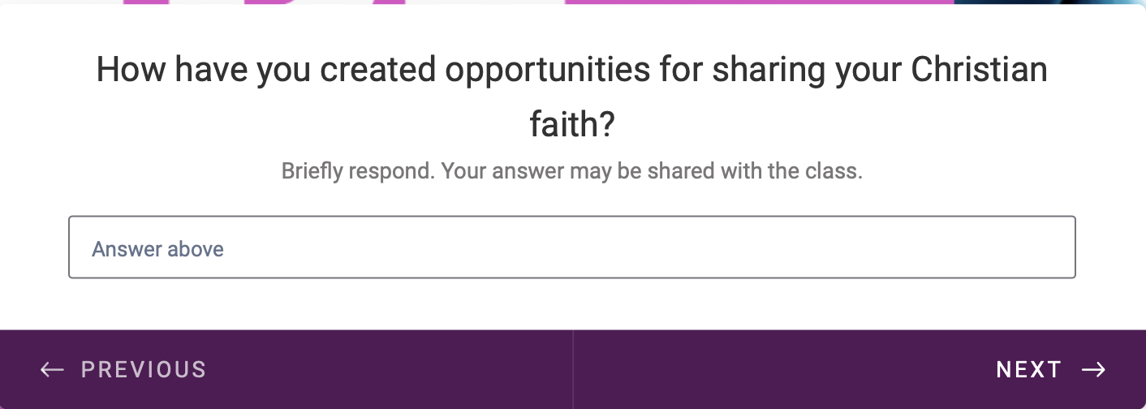
Notes:
Let me know how you have created environments and opportunities to share the Gospel.

Slide 7
IV. Where: Creating Environments for Evangelism
A. Always being prepared
B. encourage spiritual conversations
C. Home
D. Workplace
E. Community
F. Online

Slide 8
IV. Where: Creating Environments for Evangelism
"Where" evangelism takes place
Environments Naturally
Atmosphere of Sowing
Projecting a Biblical Worldview
A Natural State of Planning is OK
Notes:
IV. Where: Creating Environments for Evangelism
We need to understand "Where" evangelism takes place. The short answer is evangelism must occur where the Good News needs to be sown. Evangelism needs to happen where people need to be introduced to the God of the Bible. Where we evangelize is very important because it will help us to narrow down the places we would go if we were to plan. The task of evangelism can seem so big that we might give up before we start; therefore, if you are planning an evangelistic campaign, you have predetermined where to go. Without planning a campaign, you can create environments for evangelism to happen naturally.
It can be argued that evangelism needs to happen everywhere all the time. This is why Being Evangelism versus Doing Evangelism is so important. If we are "Being Evangelism," it is happening even if we haven't planned to do it. The Saint who is Being Evangelism is always prepared and creates the atmosphere to sow God's will into any discussion. Being Evangelism allows us to reflect on the Will of God on any topic, helping others see a worldview that accepts the existence of a sovereign God.
Planned evangelism is also ok and becomes more manageable if we are"Being Evangelism" because it is our natural state. However, a planned campaign can help sow the seed of God's Word in places we may have left unserved.
Ask question #1

Slide 9
Notes:
Answer is D. Evangelism should take place whre the Good News needs to be sown.

Slide 10
A. Always being prepared
2 Timothy 4:2
State of Readiness
Bold, patient, discerning
Urgency
Notes:
A. Always being prepared (2 Timothy 4:2)
Reflecting on 2 Timothy 4:2, evangelism is a calling that requires both readiness and adaptability. The scripture encourages us to "preach the word; be prepared in season and out of season; correct, rebuke and encourage—with great patience and careful instruction." This implies that evangelism is not a sporadic activity but a constant state of readiness to share the gospel. Whether favorable or challenging, believers are urged to share their faith boldly, patiently, and with discernment. This readiness signals the heart of an evangelist, where the urgency of sharing the Good News is ever-present, underpinned by an unwavering commitment to guiding others toward the transformative love of Christ.
Next slide - Go over scripture 2 Timothy 4:2

Slide 11
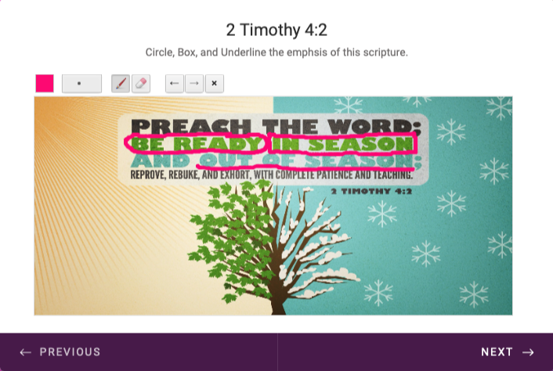
Notes:
Circle “Be Ready”
Box in “In Season”
Underline “Out of Season”

Slide 12
Notes:
Answer is C. Evangelism is a constant state of readiness, where believers are urged to share their faith in any situation with patience and discernment

Slide 13
B. encourage spiritual conversations
Foster Trust
Mutual Respect
Value others
Words and actions
Notes:
B. Fostering environments that encourage spiritual conversations
Fostering a trusting environment is fundamental to evangelism, as it allows for open and honest discussions about spiritual realities. Such an environment is characterized by mutual respect, non-judgment, and a genuine interest in understanding others' perspectives. When individuals feel safe and valued, they are more likely to engage in conversations about faith, ask questions, and express their doubts or concerns. As believers, it is our responsibility to create these trust-rich spaces, exhibiting Christ's love through our words and actions and patiently listening to and addressing the spiritual queries of others. In these nurturing environments, the seeds of faith are often sown, watered, and allowed to flourish.
Ask question #4

Slide 14
Notes:
Scriptures Reflecting Fostering Environments for Spiritual Conversations
1 Peter 3:15 - "But in your hearts revere Christ as Lord. Always be prepared to give an answer to everyone who asks you to give the reason for the hope that you have. But do this with gentleness and respect."
Colossians 4:5-6 - "Be wise in the way you act toward outsiders; make the most of every opportunity. Let your conversation be always full of grace, seasoned with salt, so that you may know how to answer everyone."
Circle, Box, Underline…
Ephesians 4:29 (ESV)
29 Let no corrupting talk come out of your mouths, but only such as is good for building up, as fits the occasion, that it may give grace to those who hear.
These scriptures emphasize the importance of fostering environments that encourage spiritual conversations and highlight the necessary attitudes and behaviors - respect, wisdom, preparedness, and kindness - to carry out this mission effectively.
Ask question #3

Slide 15
Notes:
Answer is B. An environment characterized by mutuall respect,…

Slide 16
C. Home
Beginning at Home
Parents Primary Evangelist
Leading up
Most vital witness
Notes:
C. Evangelism at Home
Evangelism should not be confined to far-flung missions or the public square. It begins at home, within the family unit. Parents are called to be the primary evangelists for their children, guiding and nurturing their spiritual development from an early age (Deuteronomy 6:6-9). Equally, children can channel God's love to their parents and siblings, living out their faith in daily interactions. By fostering a culture of open conversation about faith at home, families can support each other in their spiritual journeys and become each other's most vital witnesses.
Deuteronomy 6:6–9 (ESV)
6 And these words that I command you today shall be on your heart. 7 You shall teach them diligently to your children, and shall talk of them when you sit in your house, and when you walk by the way, and when you lie down, and when you rise. 8 You shall bind them as a sign on your hand, and they shall be as frontlets between your eyes. 9 You shall write them on the doorposts of your house and on your gates.
Ask question #4

Slide 17
Notes:
Answer is A. Evangelism should start within the family unit,…

Slide 18
Notes:
An example for the importance of Evangelism beginning at Home…
If in our church, there are 500 members. How many members would there be in 40 years if 50% of the current membership would each add one new member a year for 20 years? Then 50% of those new members would add 1 new member every other year for 20 years. Then of those new members, 50% of them would add 1 new member each every 4 years for 20 years. How many new members would that equal?
Let's break down the progression based on the information provided:
**Year 1 to Year 20:** 50% of the current members (500 members) add one new member each year.
So, \(0.50 \times 500 = 250\) new members each year for 20 years.
2. **Year 21 to Year 40:** 50% of the members added in Year 20 (250 members) add one new member every other year.
So, (0.50 \times 250 = 125).
This means 125 new members each year for the next 20 years.
3. **Year 41 to Year 60:** 50% of the members added in Year 40 (125 members) add one new member every 4 years. So, \(0.50 \times 125 = 62.5\). Since you can't have a fraction of a person, let's round down to 62.
This means 62 new members each year for the next 20 years.
Now, let's calculate the total number of new members added over the 40-year period:
[250 times 20 + 125 times 20 + 62 times 20 = 5000 + 2500 + 1240 = 8740]
So, over the 40-year period, your church would add a total of 8740 new members. If you add this to the initial membership of 500, you would have (500 + 8740 = 9240) members after 40 years.
Stop here completing week #1 of Evangelism: Where…

Slide 19
D. Workplace
Salt and light
Imposing vs. showcasing
Influence
Notes:
D. Evangelism in the Workplace
The workplace is another significant environment for evangelism. Christians are called to be 'salt and light' in their places of work, reflecting Christ's love in their interactions with colleagues, superiors, and clients (Matthew 5:13-16). This doesn't mean imposing our beliefs on others but rather showcasing the Gospel through our work ethics, attitudes, and the respectful way we treat others. It's about creating a godly influence that arouses curiosity and fosters opportunities for spiritual conversations.
Ask question #5

Slide 20
Notes:
Answer is B. Christians are called to reflect Christ’s love …

Slide 21
E. Community
Broader community
Mark 12:31
Love language
Lively stones
Notes:
E. Evangelism in the Community
Lastly, our broader communities should be a field for evangelism. Whether it's our neighbors, the local grocery store owner, the gym trainer, or the parents at our kids' school, we have unique relationships with a variety of people (Mark 12:31). Our responsibility is to be prepared to share the gospel in ways that are respectful and meaningful to them. This can be through acts of service (love language), community involvement, or simply by displaying a Christlike character in our daily interactions. By being a living testament of God's grace, we can encourage others to seek the transformation only Jesus can bring.

Slide 22
Notes:
Answer is C. Christians are responsible for sharing the gospel in respectful and meaningful ways with …

Slide 23
F. Online
Digital age
Matthew 28:19
Transcending boundaries
Discernment
Notes:
F. Evangelism Online
The internet has opened up a new evangelistic frontier in this digital age. With the power of social media platforms, blogs, podcasts, and online forums, the gospel can be shared with a global audience at the click of a button (Matthew 28:19). Online evangelism allows us to connect with people we may never meet in person, transcending geographical and cultural boundaries. It's not just about posting Bible verses or sermon snippets; it's about engaging in thoughtful discussions, offering spiritual support, and creating a welcoming online community where faith can be explored. However, online evangelism also requires discernment and respect for diversity, ensuring that the message of Christ is shared in a way that is both impactful and respectful to the digital audience.
Ask question #7

Slide 24
Notes:
Answer is D. Christians should use online platforms to connect with a globla audience,…

Slide 25
1. Question: What is the difference between 'Being Evangelism' and 'Doing Evangelism'?
Answer: ‘Being Evangelism' refers to a constant readiness to share the Gospel, irrespective of planning. It is about creating an atmosphere where discussions about God's will naturally occur. On the other hand, 'Doing Evangelism' typically refers to planned acts or campaigns of evangelism.
Notes:
Answer:

Slide 26
2. Question: Why is 'Being Evangelism' considered more natural?
Answer: ‘Being Evangelism' is considered more natural because it manifests an evangelist's inherent state. It means that sharing God's words is part of their everyday life, not limited to specific campaigns or planned activities.
Notes:
Answer:

Slide 27
3. Question: How does 2 Timothy 4:2 illustrate the preparedness required in evangelism?
Answer: 2 Timothy 4:2 underscores the need for evangelists to be prepared "in season and out of season." This means being ready to share the Gospel, correct, rebuke, and encourage others with patience and careful instruction, regardless of the circumstances.
Notes:
Answer:

Slide 28
4. Question: Why is fostering a trusting environment essential for evangelism?
Answer: A trusting environment is essential for evangelism because it encourages open and honest discussions about faith. It creates a safe space where individuals can express their doubts, ask questions, and engage in spiritual conversations.
Notes:
Answer:

Slide 29
5. Question: How can evangelism be practiced at home?
Answer: Evangelism at home begins with open discussions about faith within the family unit. Parents are called to guide their kids' spiritual development, but equally, children can reflect God's love onto their parents and siblings. Families can support each other in their spiritual journeys, becoming each other's most robust witnesses.
Notes:
Answer:

Slide 30
6. Question: How can Christians be 'salt and light' in the workplace?
Answer: Christians can be 'salt and light' in their workplaces by reflecting Christ's love in their interactions with colleagues, superiors, and clients. This reflects in their work ethics, attitudes, respectful treatment of others, and creating a godly influence that fosters opportunities for spiritual discussions.
Notes:
Answer:

Slide 31
7. Question: What are the opportunities and challenges of online evangelism?
Answer: Online evangelism allows sharing the Gospel with a global audience, transcending geographical and cultural boundaries. It's about engaging in thoughtful discussions and creating a welcoming online community. However, it also requires discernment and respect for diversity, ensuring the message of Christ is shared in a way that is both impactful and respectful to the digital audience.
Notes:
Answer:

