Slide 1
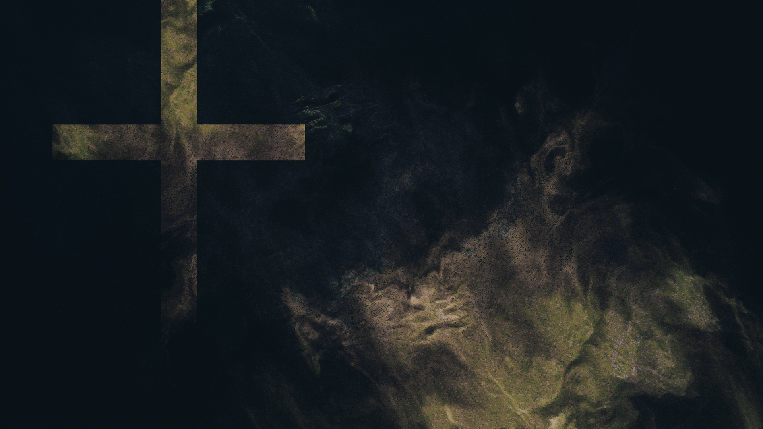
The Wisdom and Power of God
Six Miracles at Calvary
Chapter 7

Slide 2
More Confusing Than Amusing

Slide 3
24 but to those who are called, both Jews and Greeks, Christ the power of God and the wisdom of God. 25 For the foolishness of God is wiser than men, and the weakness of God is stronger than men.
1 Corinthians 1:24–25
ESV
Notes:
The cross made everything “topsy-turvy” an apparent “Oxymoron”
‌People want life
‌The Cross offers death as the way to life
‌People crave victory
‌The Cross is a defeat that leads to victory
‌People want comfort
‌The Cross is humiliation and suffering that opens the door to suffering
‌You Give to Get
‌The Last shall be First

Slide 4
Discussion Question
1. What Oxymorons of the Christian life have you experienced?
Notes:
God only does heart transplants.
‌Christianity is a Person, not a program
‌Our power is in the message of the Cross, not in man’s method.

Slide 5
Discussion Question
2. What does it mean that God does only heart transplants?
Notes:
Man does face lifts and makeovers; God does heart transplants.
‌Christianity makes a person a new creation with a new life and mind.

Slide 6
17 Therefore, if anyone is in Christ, he is a new creation. The old has passed away; behold, the new has come.
2 Corinthians 5:17
ESV

Slide 7
20 I have been crucified with Christ. It is no longer I who live, but Christ who lives in me. And the life I now live in the flesh I live by faith in the Son of God, who loved me and gave himself for me. 21 I do not nullify the grace of God, for if righteousness were through the law, then Christ died for no purpose.
Galatians 2:20–21
ESV

Slide 8
Christ, the Power of God
Notes:
What kind of God would save sinners with a cross?

Slide 9
16 For I am not ashamed of the gospel, for it is the power of God for salvation to everyone who believes, to the Jew first and also to the Greek.
Romans 1:16
ESV

Slide 10
Discussion Question
3. Who is in control at the cross? How do the scriptures make this clear?
Notes:
Genesis 1
and 2 set the stage for the remainder of the Bible that God is in charge.

Slide 11
3 He is the radiance of the glory of God and the exact imprint of his nature, and he upholds the universe by the word of his power. After making purification for sins, he sat down at the right hand of the Majesty on high,
Hebrews 1:3
ESV
Notes:
God’s strength is revealed in our weakness.
‌God’s greatest work was done on the cross!
‌All Jesus has and gives is that Cross.
‌The Church was born and still lives by that Cross.
‌There is no sin the cross cannot take away.
‌The Cross is not a freak experience. It is a universal truth incarnate.
‌Expand your thinking that Jesus wasn’t merely on a cross for 6 hours, He was on it for 33 years.
‌We also should live by that Cross it is our power from God.

Slide 12
4 For he was crucified in weakness, but lives by the power of God. For we also are weak in him, but in dealing with you we will live with him by the power of God.
2 Corinthians 13:4
ESV
Notes:
Therefore for one to receive the Gospel message, it must be received in weakness, not in strength. We call that humility!

Slide 13
Christ, the Wisdom of God
Notes:
The greatest Power of God lies in His wisdom.
‌Christ crucified is the embodiment of the wisdom of God.

Slide 14
13 Keep back your servant also from presumptuous sins;
let them not have dominion over me!
Then I shall be blameless,
and innocent of great transgression.
Psalm 19:13
ESV

Slide 15
10 and especially those who indulge in the lust of defiling passion and despise authority.
Bold and willful, they do not tremble as they blaspheme the glorious ones,
2 Peter 2:10
ESV
Notes:
Man presumes that the way he thinks is the way God thinks, or should think.
‌Man’s Psychology promises to make life better.
‌Christ gives sinners, life, period!
‌Dead men need life, not rehabilitation!
‌Man wants salvation from war, poverty, and disease.
‌Christ on the cross saves us from sin.
‌Man cannot solve war, poverty, or disease until he is saved from sin.
‌Sin can only be cured at the Cross.
‌To the intellectually proud, the cross is still folly.
‌Man wants power, not wisdom - enlightenment not faith.
‌Man would take the cross away from Jesus and many desire to take it away from the Church.
‌Believe and Teach the Cross.

Slide 16
* Never lose faith in the Power of the Gospel.
* Stop trying to be
* Godly without God
* Spiritual without the Spirit

Slide 17
Six Miracles At Calvary
Notes:
Jews kept asking Jesus for a sign and several miracles were done at the crucifixion.

Slide 18
6 When Jesus said to them, “I am he,” they drew back and fell to the ground.
John 18:6
ESV

Slide 19
Discussion Question
4. What was the last miracle Jesus performed for the Jews? describe it...
Notes:
Jesus healed Malchus ear after Peter cut it off
‌
‌Let’s also remember the miracle that did not happen.

Slide 20
53 Do you think that I cannot appeal to my Father, and he will at once send me more than twelve legions of angels? 54 But how then should the Scriptures be fulfilled, that it must be so?”
Matthew 26:53–54
ESV
Notes:
a Roman legion was 3000-6000 foot soldiers

Slide 21
1. Darkness

Slide 22
12 while the sons of the kingdom will be thrown into the outer darkness. In that place there will be weeping and gnashing of teeth.”
Matthew 8:12
ESV
Notes:
some say a preview of Hell was the darkness at the cross

Slide 23
45 Now from the sixth hour there was darkness over all the land until the ninth hour.
Matthew 27:45
ESV
Notes:
The shame of Calvary smothered the Sun
‌

Slide 24
2. The Veil

Slide 25
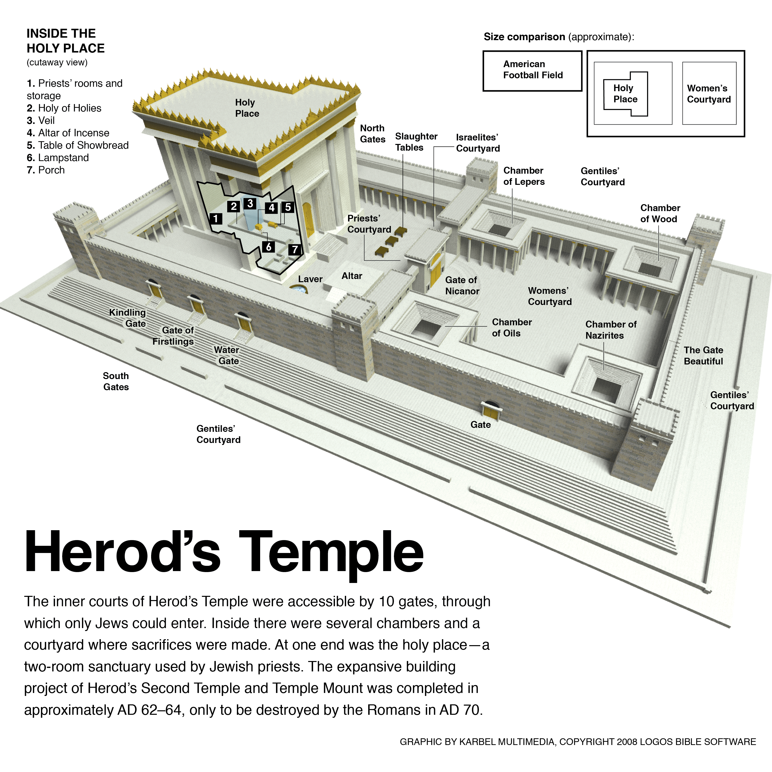
Notes:
at 3pm before the eyes of the priests the veil was torn

Slide 26
51 And behold, the curtain of the temple was torn in two, from top to bottom. And the earth shook, and the rocks were split.
Matthew 27:51
ESV

Slide 27
3. The Earthquake
Notes:
Roman soldiers were awed

Slide 28
54 When the centurion and those who were with him, keeping watch over Jesus, saw the earthquake and what took place, they were filled with awe and said, “Truly this was the Son of God!”
Matthew 27:54
ESV

Slide 29
4. The Opened Graves
Notes:
What an unusual earthquake and only selected graves were opened!

Slide 30
52 The tombs also were opened. And many bodies of the saints who had fallen asleep were raised, 53 and coming out of the tombs after his resurrection they went into the holy city and appeared to many.
Matthew 27:52–53
ESV
Notes:
no wonder the spectators beat their breasts

Slide 31
48 And all the crowds that had assembled for this spectacle, when they saw what had taken place, returned home beating their breasts.
Luke 23:48
ESV

Slide 32
5. The Grave Clothes
Notes:
the last thing enemies wanted was an empty tomb

Slide 33
6. The Resurrected Saints
Notes:
This would have caused a big problem for the Jews because they would have been considered unclean for coming in contact with the dead.
‌

Slide 34
Discussion Question
5. Which sign/ miracle do you find intriguing?

