Slide 1
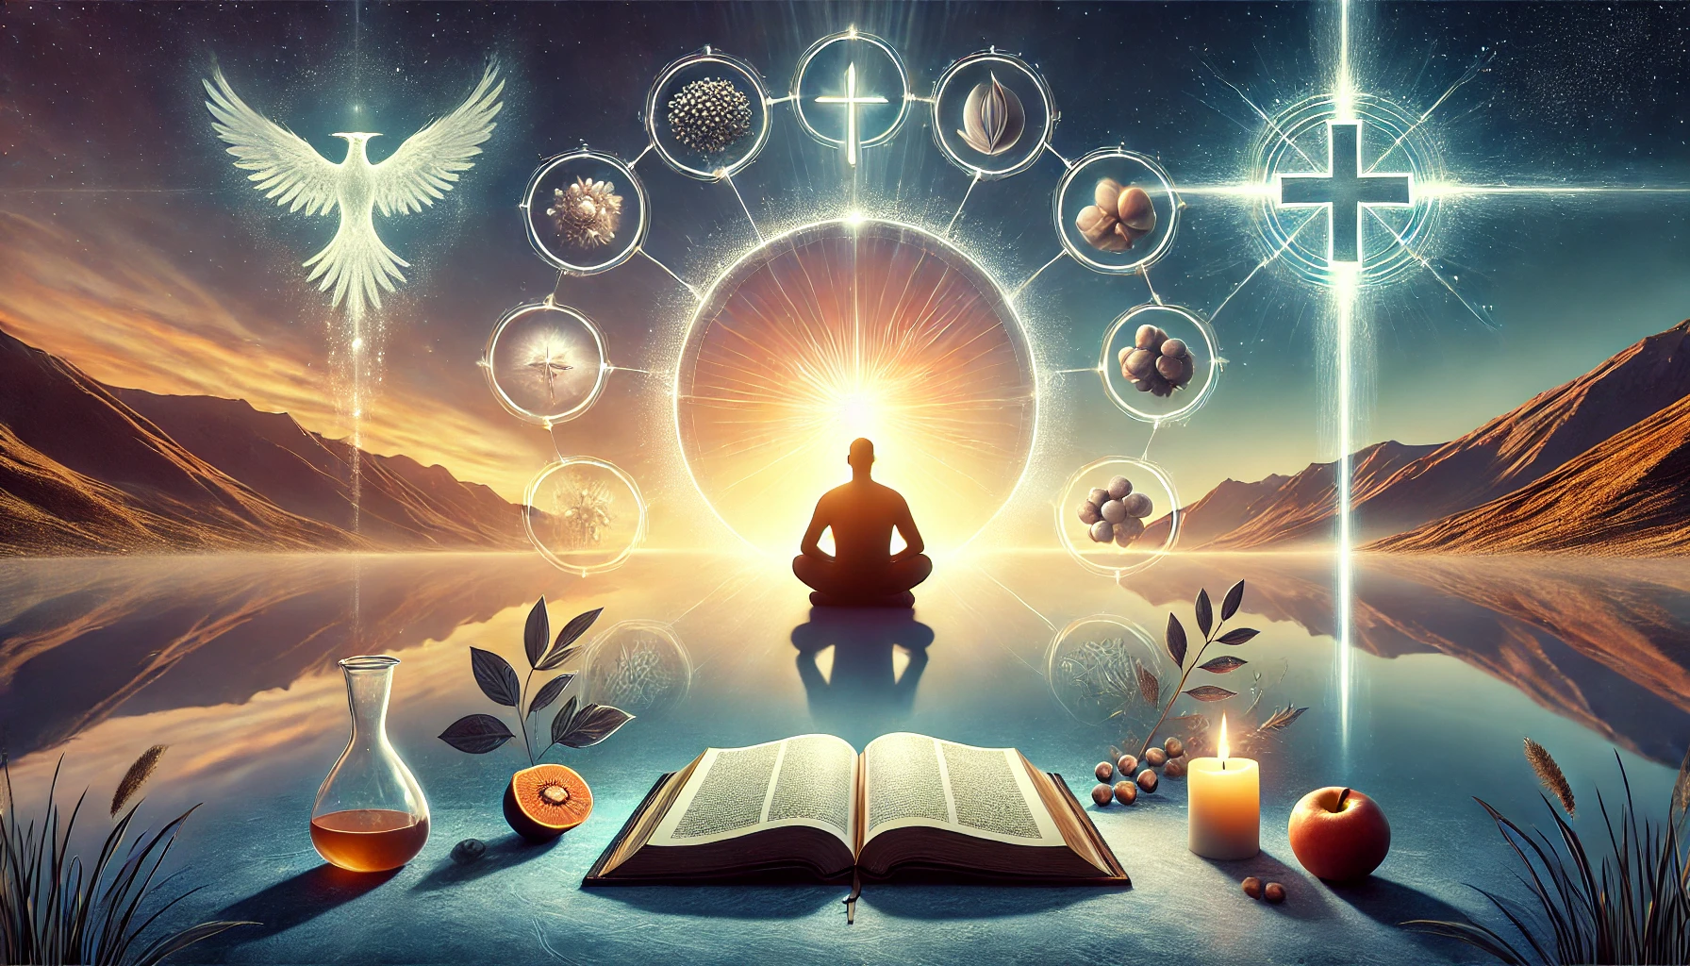
The Power of Self-Control

Slide 2
24 Do you not know that in a race all the runners run, but only one receives the prize? So run that you may obtain it. 25 Every athlete exercises self-control in all things. They do it to receive a perishable wreath, but we an imperishable. 26 So I do not run aimlessly; I do not box as one beating the air. 27 But I discipline my body and keep it under control, lest after preaching to others I myself should be disqualified.
1 Corinthians 9:24–27
ESV

Slide 3
Self-Control
the Produce of the Spirit

Slide 4
31 So the church throughout all Judea and Galilee and Samaria had peace and was being built up. And walking in the fear of the Lord and in the comfort of the Holy Spirit, it multiplied.
Acts 9:31
ESV

Slide 5
4 in order that the righteous requirement of the law might be fulfilled in us, who walk not according to the flesh but according to the Spirit.
Romans 8:4
ESV

Slide 6
2 in which you once walked, following the course of this world, following the prince of the power of the air, the spirit that is now at work in the sons of disobedience—
Ephesians 2:2
ESV

Slide 7
Absence of Self-Control

Slide 8
Examples Absent Self-Control
1. Cain and Abel – Gen. 4:1-16
2. Esau – Gen. 25:29-34
3. Samson – Jud. 14-16
4. King Saul – 1 Sam. 13:8-14; 15:9-23
5. David and Bathsheba – 2 Sam. 11
6. Peter’s Denial of Jesus – Lk. 22:54-62
7. Judas Iscariot – Mat. 26:14-16, 47-50

Slide 9
Presence of Self-Control

Slide 10
Examples Presence of Self-Control
1. Joseph - Gen. 39:7-12
2. David Sparing Saul – 1 Sam. 24:1-7; 26:7-11
3. Daniel – Dan. 1:8-16; 6:4-10
4. Jesus in the Wilderness – Mat. 4:1-11
5. Nehemiah – Neh. 5:14-19
6. Paul – 1 Cor. 9:24-27; 2 Cor. 11:23-28
7. Stephen – Acts 7:54-60

Slide 11
Self-Control and
the Essence of the Gospel

Slide 12
Live a Life Worthy of the Calling: Ephesians 4:1-2

Slide 13
Demonstrating the Fruit of the Spirit: Galatians 5:22-23

Slide 14
Reflecting Christ's Example: Matthew 4:1-11

Slide 15
The Power of Self-Control

